Slide 1


Asset Management Presents:
Affirmative Fair Housing Marketing Plan (AFHMP)
La Tonya F. James, Training Specialist
February 2021

Slide 2
Learning Lab: OnDemand Training Model
Pre-recorded webinar
  To reach more people
  Watch at your convenience
  Can replay anytime
  Posted on IHDA’s Website
Submit your questions to learninglab@ihda.org
  We will follow up with an official FAQ within 30 days after the training date

Slide 3

Learning Objectives:
Understand the purpose of the Affirmative Fair Housing Marketing Plan (AFHMP) in accordance with IHDA requirements and guidelines.
  Introduction
  Procedures
  Submission Requirements

Slide 4
Affirmative Fair Housing Marketing Plan (AFHMP)
Introduction
Each multifamily development receiving an IHDA funded loan, grant financing and/or Tax Credit Allocation must establish adherence to fair housing guidelines by implementing an Affirmative Fair Housing Marketing Plan. Such marketing efforts are to be directed towards demographics who, due to the development’s geographic location or other factors, are considered those “least likely” to apply for housing at the project. The marketing program must also include outreach efforts to all persons with disabilities, along with highlighting apartments with accessible or adaptable features in detail to demonstrate specific outreach efforts to persons with physical disabilities.

Slide 5

Affirmative Fair Housing Marketing Plan (AFHMP)
IHDA Requirements
Affirmative Fair Housing Marketing Plans (AFHMP) are required of developments when they receive financing or allocation of tax credits from IHDA.
The AFHMP must be updated every 5 years.
A new AFHMP is required when there is a change of Owner and/or Agent.
Remember to:
Submit your
AFHMP every five years prior to expiration.

Slide 6

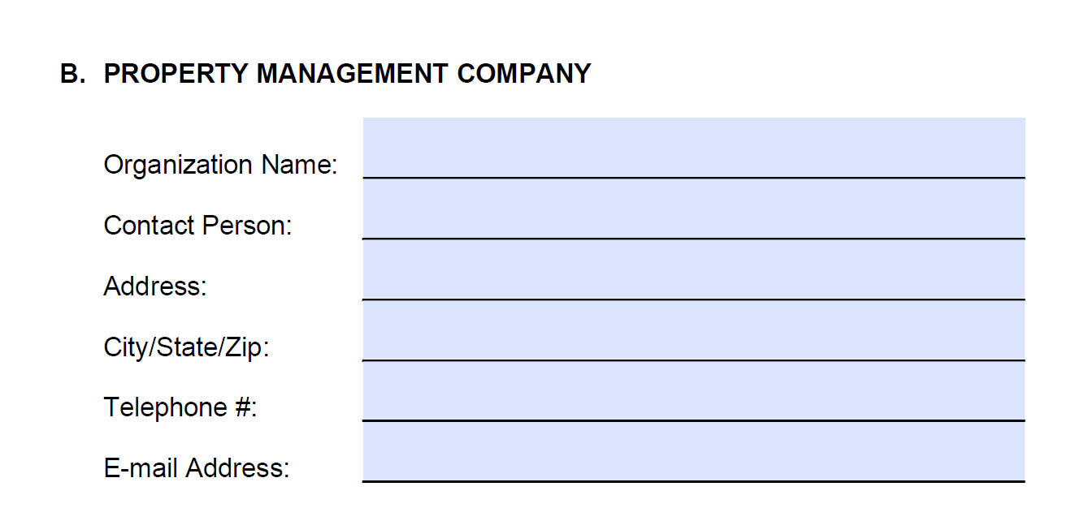
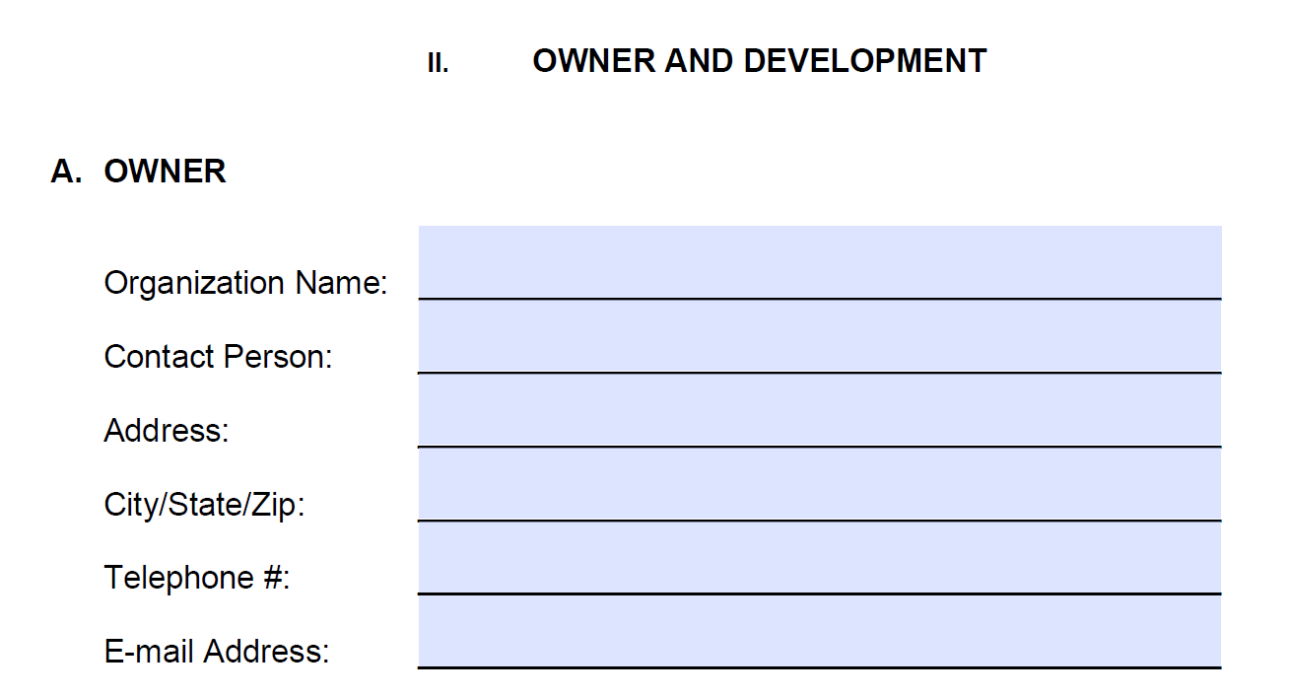
Affirmative Fair Housing Marketing Plan (AFHMP)
IHDA Procedures
Owner Organization Name must match the name and information listed on the IHDA legal documents.
Contact Person is the primary owner and management representative that can be contacted in the event of any questions.
Property Management Company must match the information previously provided to IHDA.
Complete each section entirely, providing all requested contact information.

Slide 7
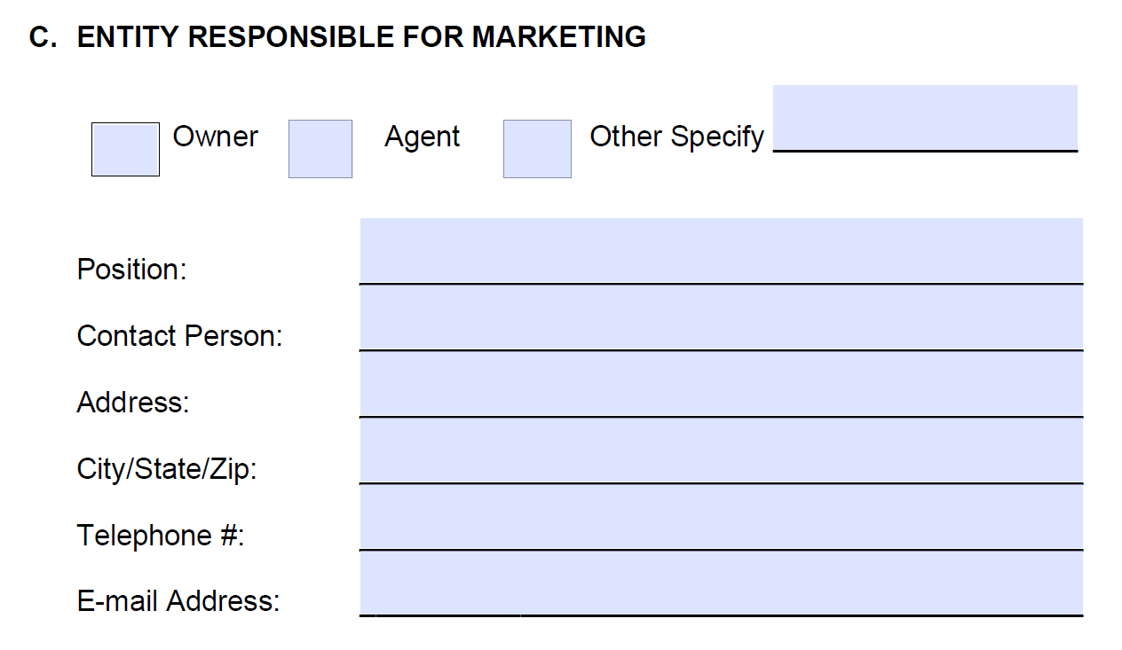
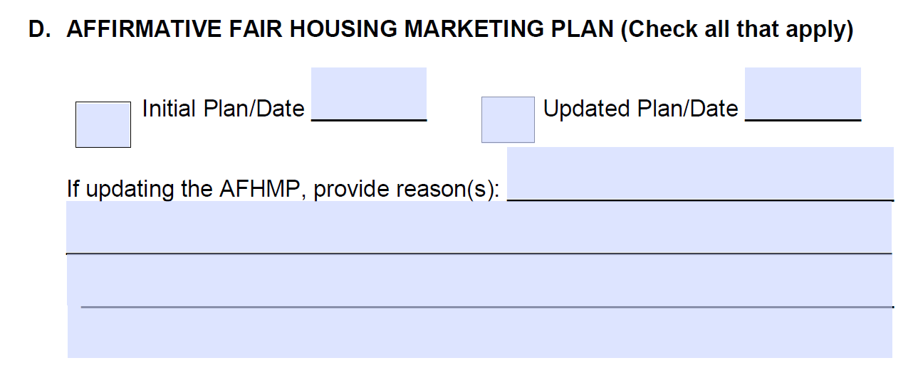
Affirmative Fair Housing Marketing Plan (AFHMP)
IHDA Procedures
Identify the Entity and Contact Person responsible for the marketing activities.
Indicate the basis of submission (Ex. Initial or Updated Plan).
Provide an explanation if updating the AFHMP prior to expiration.

Slide 8
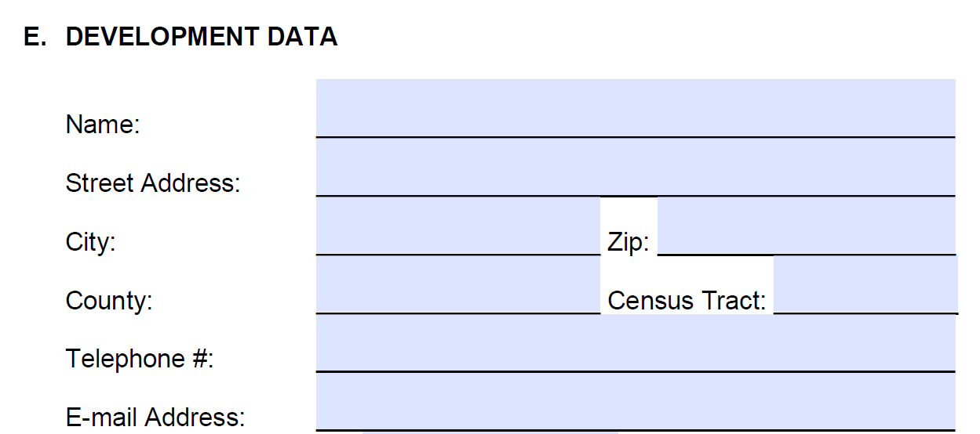
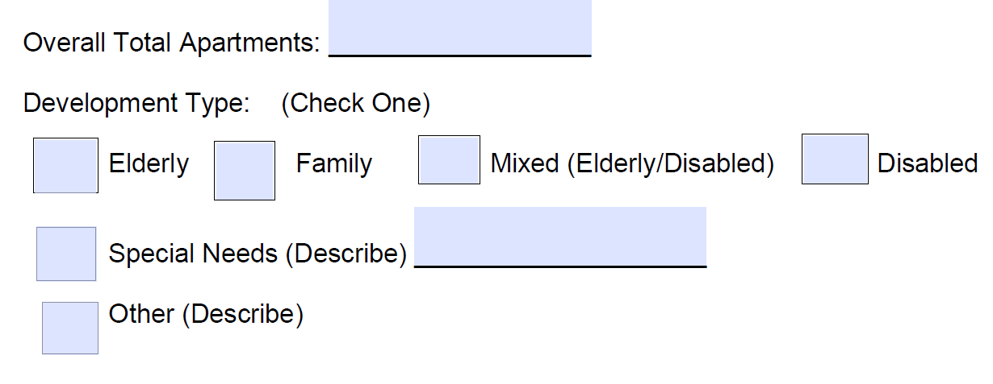
Affirmative Fair Housing Marketing Plan (AFHMP)
IHDA Procedures
Enter the name of the Development and pertinent information as requested.
If there are multiple addresses and one location includes the management office, enter that address and add “Scattered Sites.”
Census Tract – Obtain specific development information from https://data.census.gov/cedsci/.
Include the overall total apartments and Development Type, providing additional details as needed.

Slide 9

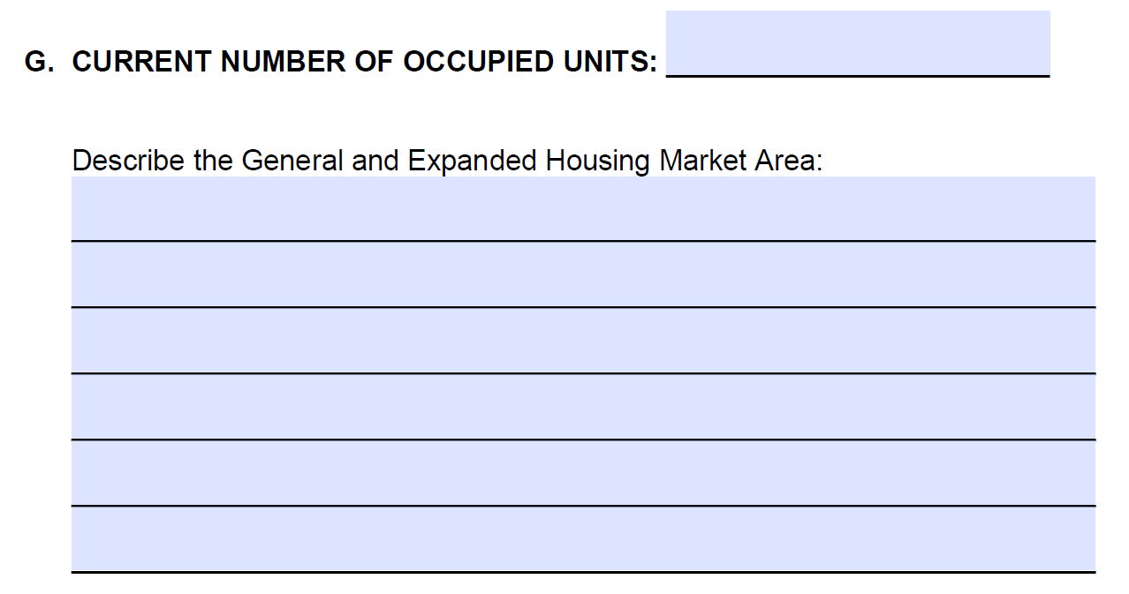
Affirmative Fair Housing Marketing Plan (AFHMP)
IHDA Procedures
Specify the date of initial occupancy after general advertising commences.
For initial or existing developments, indicate the date advertising will begin/began for existing vacancies, wait list placement, or to re- open a closed waiting list.
Provide the current number of occupied units at the time of the AFHMP submission.
Describe in detail, the development’s primary market area including general geographic boundaries of the primary market area.

Slide 10
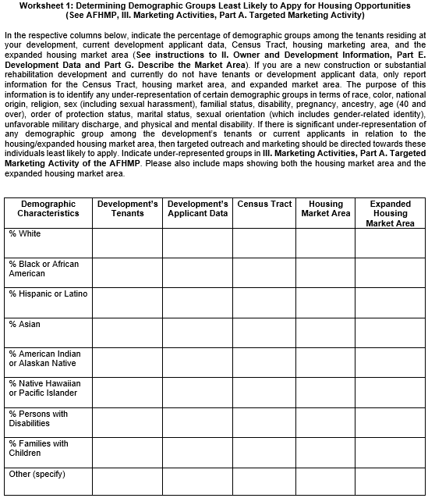
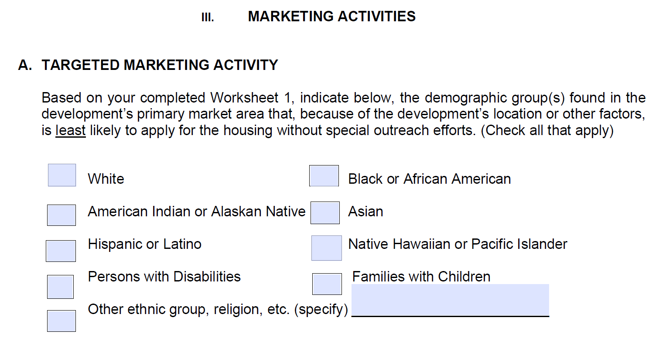
Affirmative Fair Housing Marketing Plan (AFHMP)
IHDA Procedures
Indicate “least likely” to apply demographic groups upon completing Worksheet 1.

Slide 11
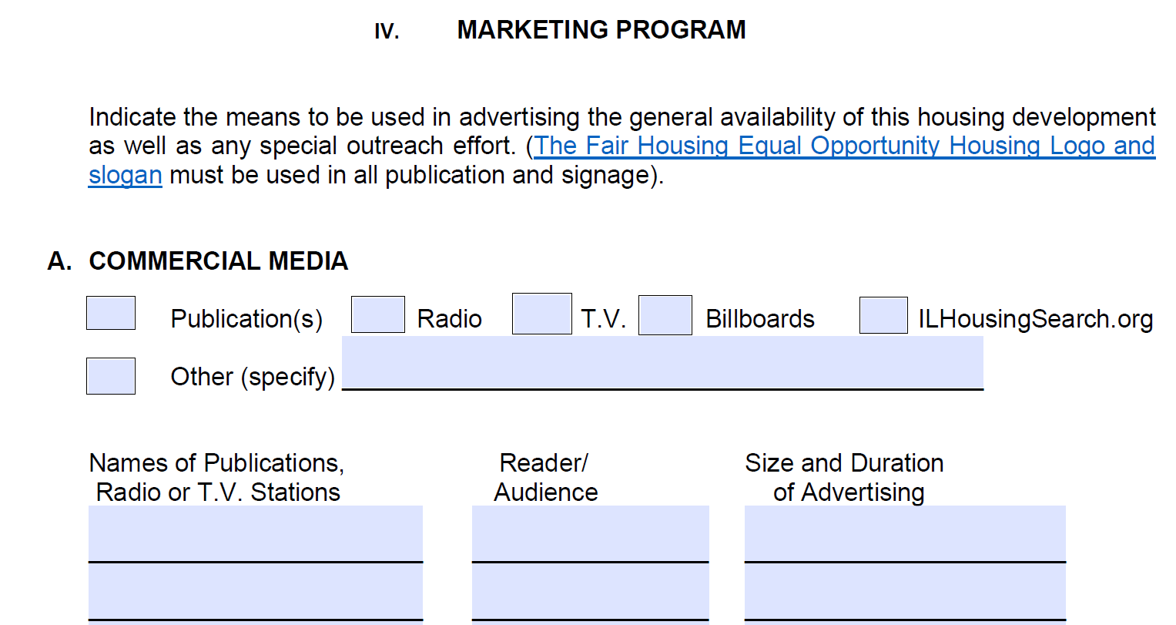
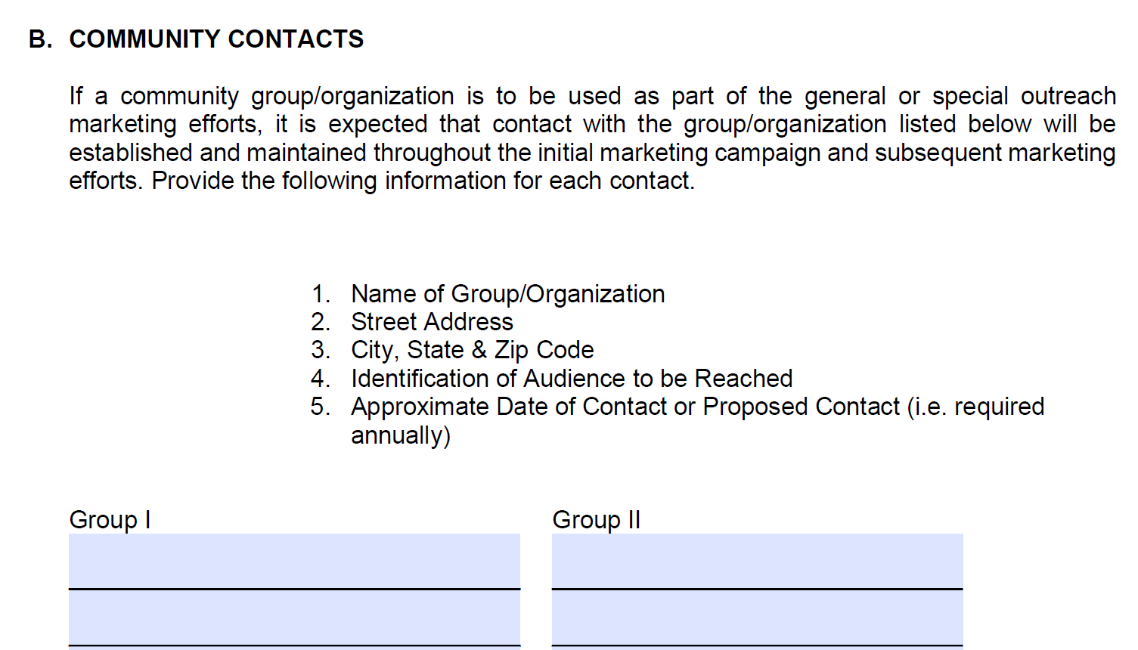

Affirmative Fair Housing Marketing Plan (AFHMP)
IHDA Procedures
Describe the marketing program to be used to attract all segments of the eligible population, specifically those “least likely,” to apply, including local community contacts that your development will partner with to advance marketing efforts.
Ilhousingsearch.org is a mandatory requirement of IHDA.

Slide 12
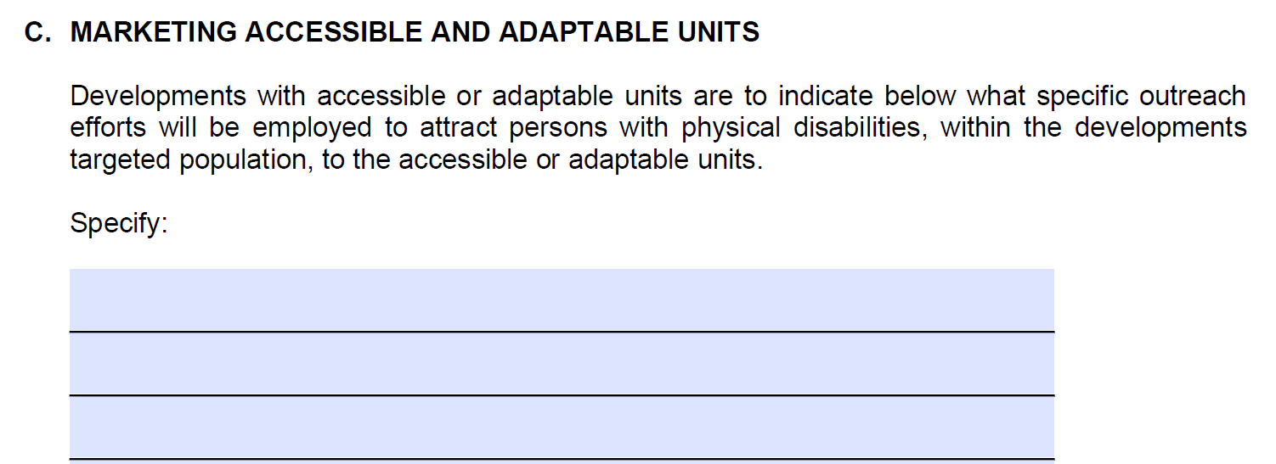
Affirmative Fair Housing Marketing Plan (AFHMP)
IHDA Procedures
Explain what efforts will be made to attract applicants with physical disabilities to the Development, and include any publications and organizations utilized. Indicate N/A if the development does not have accessible or adaptable units. For SRN units, include SRN contact information.

Slide 13
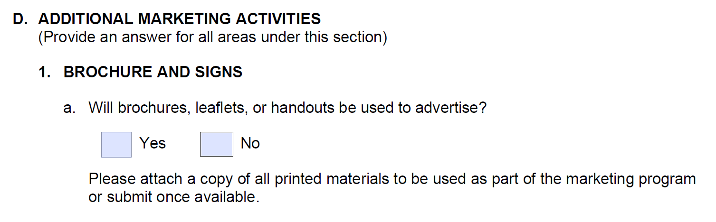
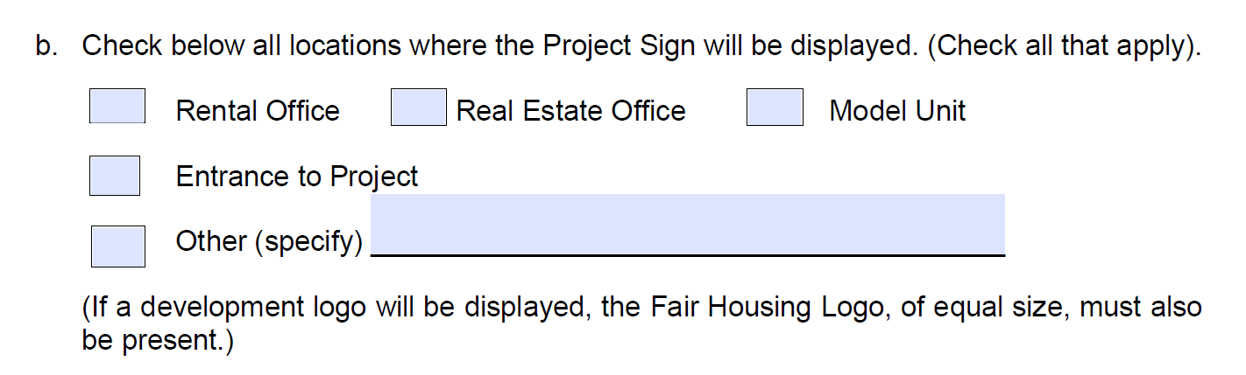
Affirmative Fair Housing Marketing Plan (AFHMP)
IHDA Procedures
Indicate if the Development will use brochures to advertise and if yes, attach copies of the printed material to the AFHMP.
Identify the location of the Project Sign.

Slide 14
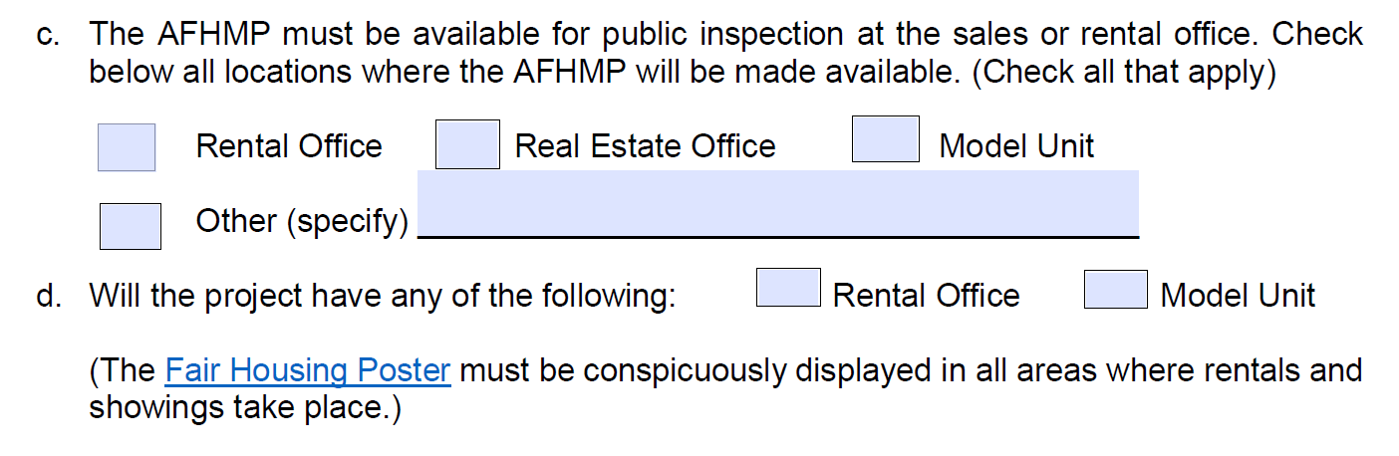
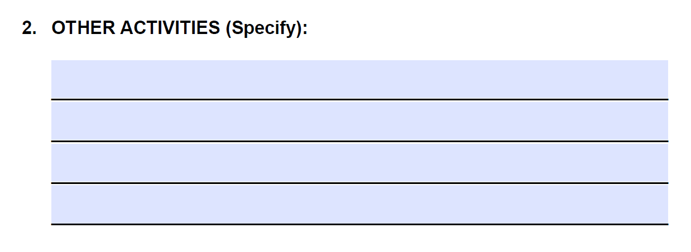
Affirmative Fair Housing Marketing Plan (AFHMP)
IHDA Procedures
Identify the location where a copy of the AFHMP will be available for public inspection.
Indicate if the Development will have a Rental Office and/or Model Unit.
Other Activities must be specified in the area provided.

Slide 15
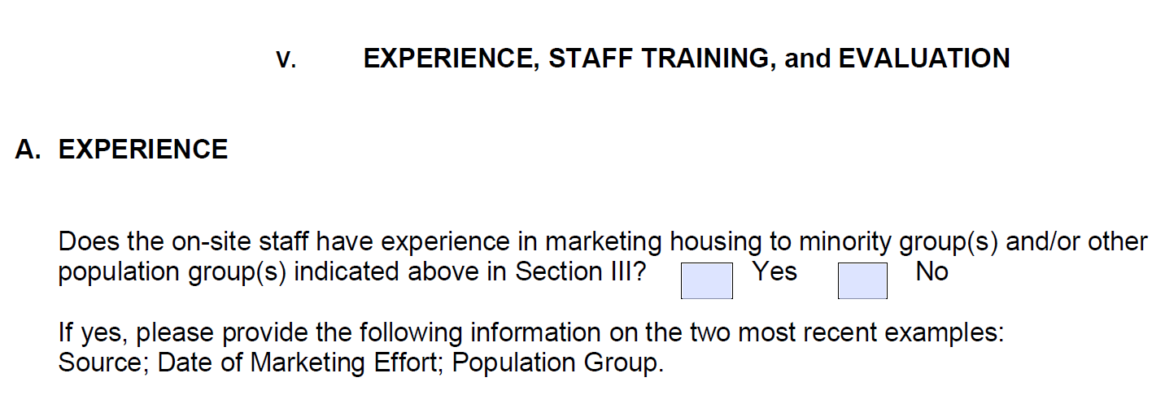

Affirmative Fair Housing Marketing Plan (AFHMP)
IHDA Procedures
Confirm on-site staff marketing experience with minority and other groups.
Provide two most recent marketing examples .
List Examples Here

Slide 16
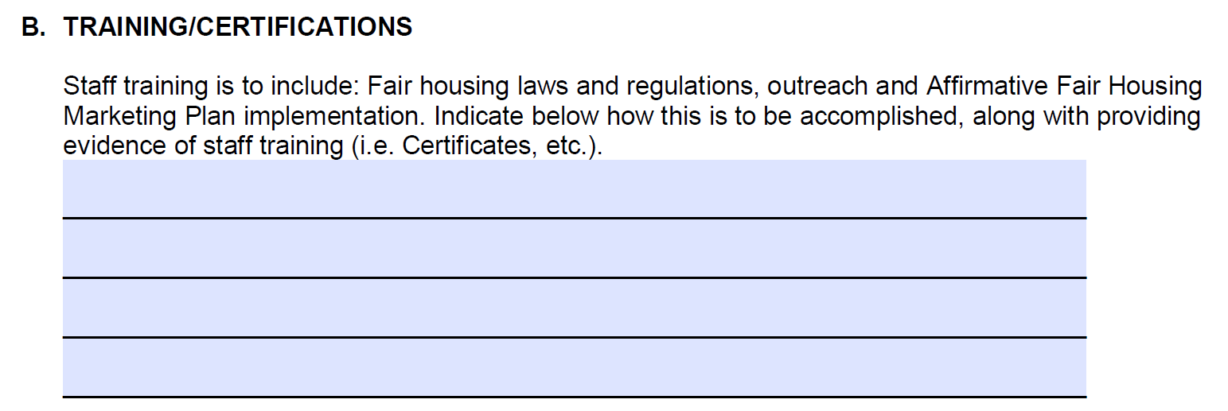
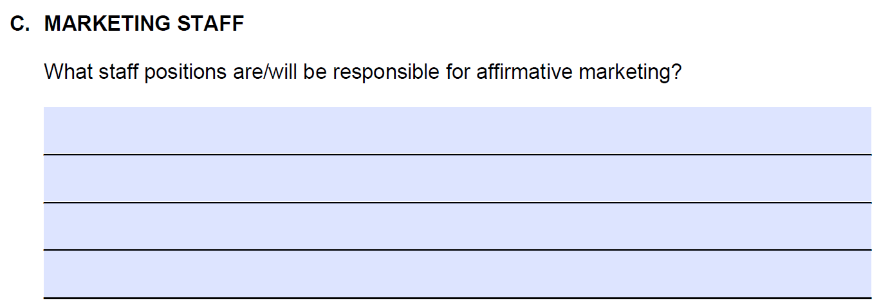
Affirmative Fair Housing Marketing Plan (AFHMP)
IHDA Procedures
Provide detailed staff training and copies of certificates.
Indicate staff positions responsible for affirmative marketing.

Slide 17
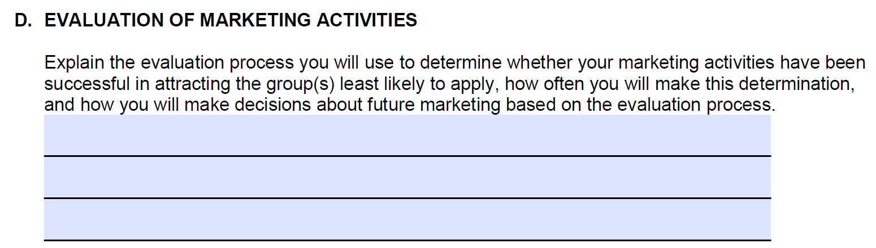

Affirmative Fair Housing Marketing Plan (AFHMP)
IHDA Procedures
Provide information to support your evaluation process to ensure successful management and implementation of the AFHMP.

Slide 18
Affirmative Fair Housing Marketing Plan (AFHMP)
IHDA Required Attachments
Census Tract Data
Worksheet 1: Determining Demographic Groups “Least Likely” to Apply for Housing Opportunities, along with a map showing both the housing market area and the expanded housing market area.
Copy of Ilhousingsearch.org website registration.
Picture of Project Signage
All Advertisements
Invoices for Radio, TV or Billboards
Brochures, leaflets or handouts
All notification to community groups/organizations
Staff training certificates

Slide 19
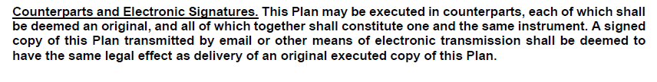
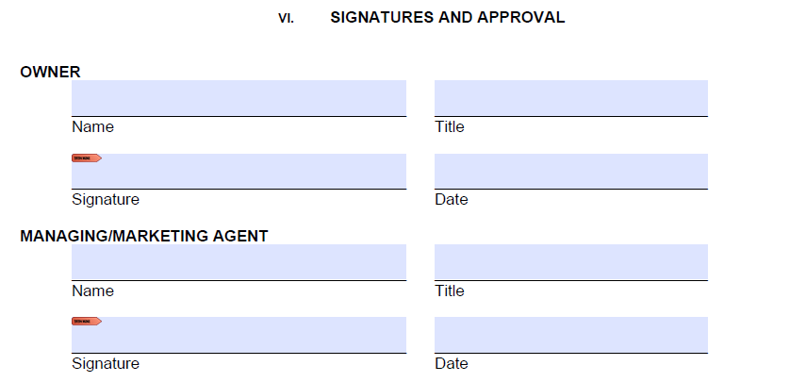

Affirmative Fair Housing Marketing Plan (AFHMP)
IHDA Certification
Provide Owner/Agent signatures, titles and date the AFHMP.
This Plan may be executed in counterparts.

Slide 20
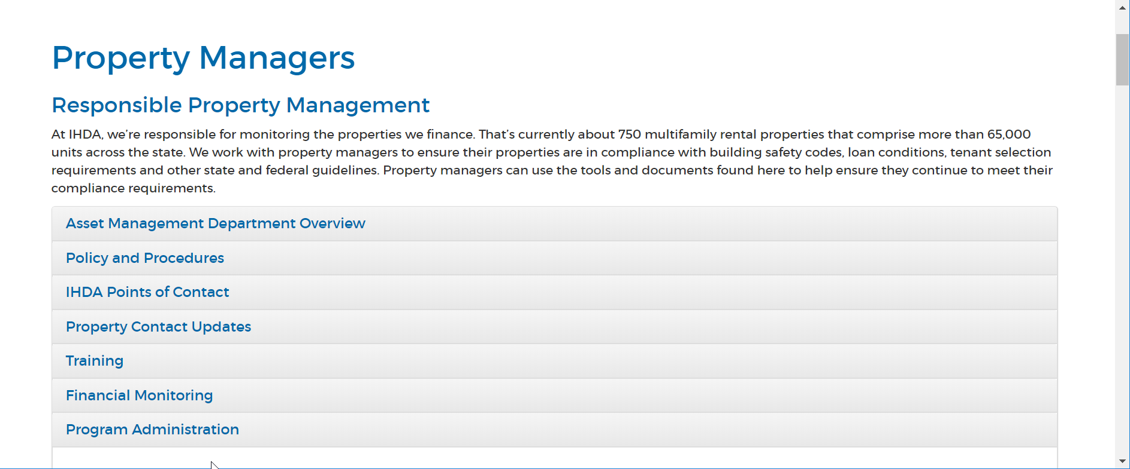
Where is this form?
https://www.ihda.org/property-managers/

Slide 21

Thank You!
Submit questions to:
learninglab@ihda.org
Subject Header: Affirmative Fair Housing Marketing Plan Training

