Slide 1


Asset Management Presents: Preparing for Financial Audit
Presented By: Leslie Cain, Training Specialist
March 2020
Notes:
Greetings, from the Illinois Housing Development Authority’s Learning Lab. My name is Leslie Cain your training specialist. Today AMS Presents…

Slide 2
Shout Out! Financial Analyst Team
Kat Kimmel, Supervisor Finance & Data Integration

Slide 3

Preparing for Financial Audit: Learning Objectives
Find the Audit Guidelines on IHDA’s website
Changes to IHDA’s Audit Guidelines / Exhibit A
Overview of the Auditing Process
  Contents of the Audited Financial Statements
  Reporting Requirements
  Due Dates
IHDA’s Key Points of Contact
  Submission
  Extension Requests
  Where to Direct Questions

Slide 4
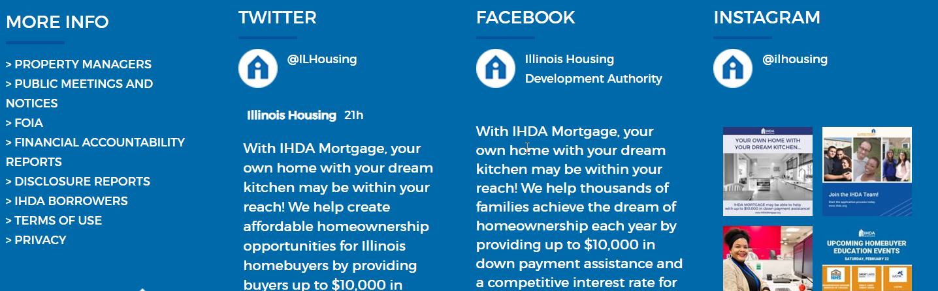
IHDA Website: Where to Find the Audit Guidelines & Documents
Step 1: Navigate to the bottom of any tab on the IHDA website
Click on“Property Managers”

Slide 5
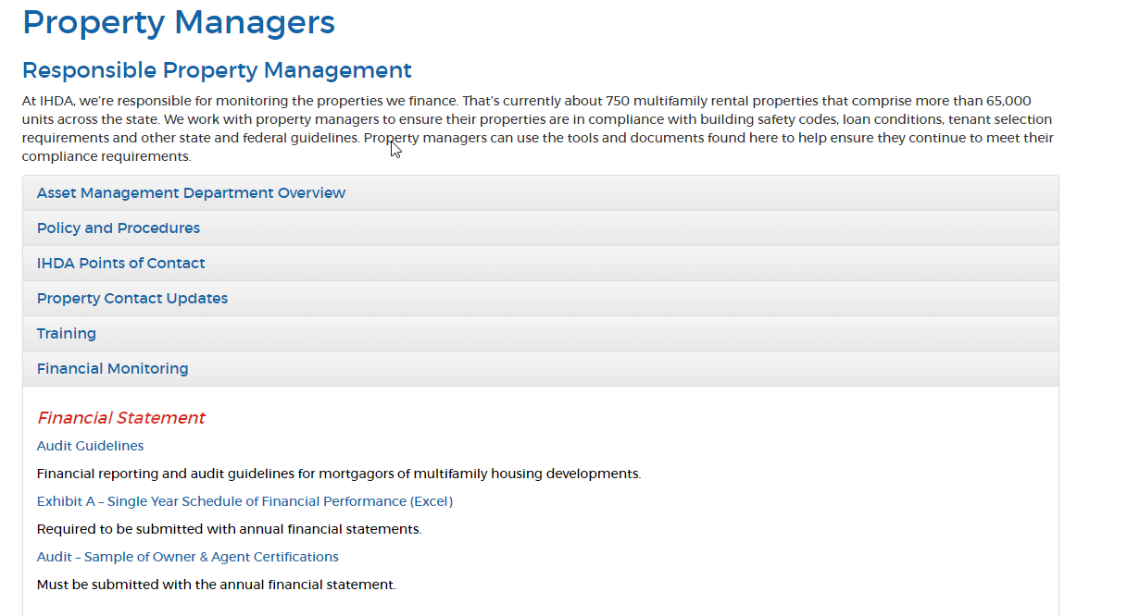
IHDA Website: Where to Find the Audit Guidelines & Exhibit A
https://www.ihda.org/property-managers/
Step 2: Click on Financial Monitoring
Notes:
Navigate to the bottom of IHDA’s website to find the Property Manager link

Slide 6
Changes to the Audit Guide / Exhibit A
As of July 1st, 2019, IHDA changed its Multifamily Audit Guidelines
Cashflow Statements - Accounting Standards updates in reporting on reserve deposits & withdrawals
Expense Categories – New categories for operations & cash flow statements (Exhibit A)
  If your specific line item is not listed use “Other”
Inclusion of a Debt Coverage Ratio (DCR) calculation to facilitate IHDA financial reviews (Exhibit A)
Refer to the Management Bulletin #486 distributed on January 17th IHDA Website, Financial Monitoring https://www.ihda.org/property-managers/
Notes:
As of July 1st, IHDA made changes to its Auditing Guidelines. The document can be found on IHDA’s website.
Bullet #1: To better deal with restricted cash as projected on the cashflow statement, IHDA made updates to accounting standards in reporting reserve deposits and withdrawls.
Bullets #2-#3 Exhibit A
to the Expense Categories on Exhibit A. Based on your feedback we added more categories. IHDA does not anticipate adding any additional categories at this time. So be sure to use “Other” if your particular line item is not represented.
IHDA also now includes a Debt Coverage Ratio calculation to aid in IHDA’s review of development financials
If you have specific questions about these changes or how these changes impact your development contact your Financial Analyst.

Slide 7

Which Financial Reporting Requirements Should You Use?
Either audited financial or CPA-certified financial statements
  Be sure to include property specific information and/or property-specific statements in your supplemental information
Review your Loan Documents, Mortgage Note or Regulatory Agreement
Loan Documents
Mortgage Note
Regulatory Agreement
Notes:
Bullet #1. Every effort should be made to provide property-specific information, whether the entire report references one property or property-specific statements be sure that your specific development’s scenario is included in your supplemental information.

Slide 8
Financial Reporting Requirement Method: Regulatory Agreement “Borrower Duties”
DEVELOPMENT A:
Annual Financial Statement Report, Section 5. Borrower Duties (@pg6)
Financial and Expense Reports. Within ninety (90) days following the end of the Borrower’s fiscal year, in a manner prescribed by the Authority in writing, Borrower shall furnish the Authority with a complete annual financial report for the Development based upon an examination of the books and records of the Development, prepared at Borrower’s expense in accordance with the written requirements of the Authority, and certified to Borrower by an Illinois licensed certified public accountant.
OR
DEVELOPMENT B:
Certified Audited Financial Statement Report, Section 7. Borrower Duties (@pg13)
Financial Statement. Within ninety (90) days following the end of each Calendar Year (commencing with the first year following the Final Closing Date), Borrower shall furnish to IHDA a complete audited financial statement report for the Development based upon an examination of the books and records of Borrower, prepared at Borrower’s expense in accordance with the GAO Standards, generally accepted accounting principles and such other standards as IHDA may require, and certified to Borrower by an Illinois licensed certified public accountant, or other person acceptable to IHDA.
Notes:
Here’s an example from two different developments with two different Regulatory Agreements. You will look for either Section 5 or Section 7 “Borrower Duties” to identify which financial reporting requirement method your development should use.

Slide 9

Financial Reporting: Audited Financial Stmt.
Audited Financial Statements include the following:
Balance Sheets
Statement of Partners’ Equity
Statement of Operations
Statement of Cashflow
Notes to the statements
Supplemental Information
Debt Service
Findings, Questioned Costs, & Corrective Action Plans
Multifamily Audit Guide, IHDA Website, Financial Monitoring https://www.ihda.org/property-managers/
Notes:
For developments required to submit Audited Financial Statements include the following.
Refer to the sample financial statements in the Multifamily Audit Guide page 10

Slide 10
Audited Financial Statement (cont.)
Independent Auditor's report on Internal Control Structure
Independent Auditor’s Report on Compliance with
  Specific Requirements Applicable to Major HUD Programs
  Specific Requirements Applicable to Non-Major HUD Transactions-Compliance
IHDA’s principal subsidy program - Section 8 rental subsidies
Certificate of General Partner
Certificate of Managing Agent
Multifamily Audit Guide, IHDA Website, Financial Monitoring https://www.ihda.org/property-managers/

Slide 11

Financial Reporting: CPA Certified Financial Statements
CPA-Certified Statements include the following:
Balance Sheets
Statement of Operations
Statement of Cashflow
Debt Service
Certificate of General Partner
Certificate of Managing Agent
Multifamily Audit Guide, IHDA Website, Financial Monitoring https://www.ihda.org/property-managers/
Notes:
For developments required to submit CPA Certified Financial Statements include the following.
Refer to the sample financial statements in the Multifamily Audit Guide page 10

Slide 12
Which Surplus Cash Calculation Requirements Should You Use?
  Mortgage Note = Payment Requirements
  Regulatory Agreement / Loan Documents = Limited Distributions to Partners
  Exhibit A: Use the MS Excel document “as is”. Please don’t add categories, formulas, cells or rows
Loan Documents
Mortgage Note
Regulatory Agreement
Notes:
Exhibit A/Surplus Cash – You’ll need to check your loan documents to determine which method should be used.

Slide 13
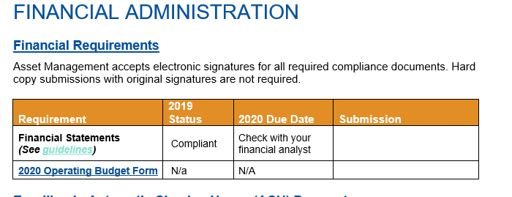
Financial Reporting Submission Due Dates
Annual Compliance Guide
March 30th, 2020
Notes:
Refer to your development’s Compliance Guide recently distributed on February 24th.
Your 2020 submission due date is based on your company’s year end. Here’s an example (next slide)
Due dates are development dependent ~ some must submit their financials within 90 days of the end of their fiscal year and some must submit within 120. Refer to your loan documents.

Slide 14
Important Contact Information & References
Submit Financial Reporting: (Loan Doc, Surplus Cash Calculation & Exhibit A Submission)
fpateam@ihda.org
General Questions:
Your assigned financial analyst outlined in your Compliance Guide
Notes:
If you have questions regarding this presentation or IHDA’s changes to its Audit Guidelines contact your Financial Analyst ~ identified in your Compliance Guide.

Slide 15
Thank you for viewing…
Asset Management’s
Preparing for Financial Audit

